Slide 1

Data Warehouses
Lecture # 2
Topic : Dimensional Modeling
Prepared by: Basem Khalaf
Semster-1 , Level-3
Fall 2023

Slide 2
Agenda
Normalization and De-Normalization
Dimensional Modeling vs. Entity-Relationship Modeling
Dimensional Modeling Concepts and Principles
DM- Fact Tables and Dimension Tables
Star and Snowflake Schemas
Slowly Changing Dimensions (SCD) Techniques

Slide 3
Normalization
Definition:
A database design technique to reduce redundancy and dependency by organizing data into smaller, related tables.
Goals of Normalization:
Minimize data redundancy.
Ensure data integrity and consistency.
Efficiently manage updates, inserts, and deletions.
Forms of Normalization (Common Levels):
1NF (First Normal Form): Eliminate repeating groups.
2NF (Second Normal Form): Remove partial dependencies.
3NF (Third Normal Form): Eliminate transitive dependencies.

Slide 4
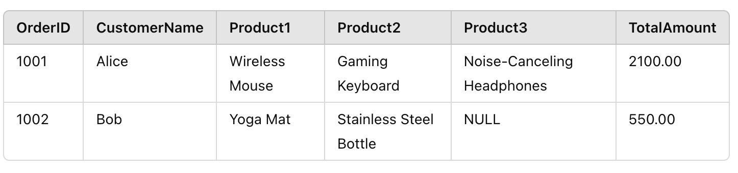
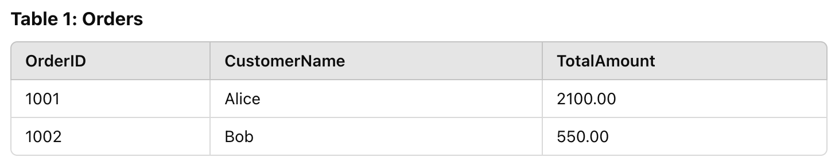
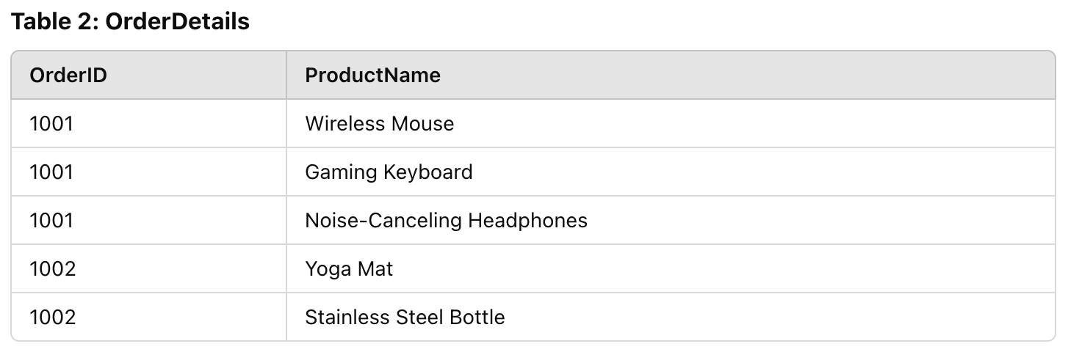
Normalization
Unnormalized Table
Notes:
Unnormalized Table: Contains repeated columns (Product1, Product2, Product3), leading to redundancy and a rigid structure.
Normalized Tables:
The Orders table holds general order information (OrderID, CustomerName, TotalAmount).
The OrderDetails table stores individual product details for each order, creating a many-to-one relationship with the Orders table.

Slide 5
Denormalization
Definition:
A database optimization technique where normalized tables are combined for performance improvements.
Purpose:
Reduce complex joins.
Speed up query execution in analytical and reporting systems.
When to Use Denormalization:
In data warehouses or OLAP systems.
When query performance is more critical than storage efficiency.

Slide 6
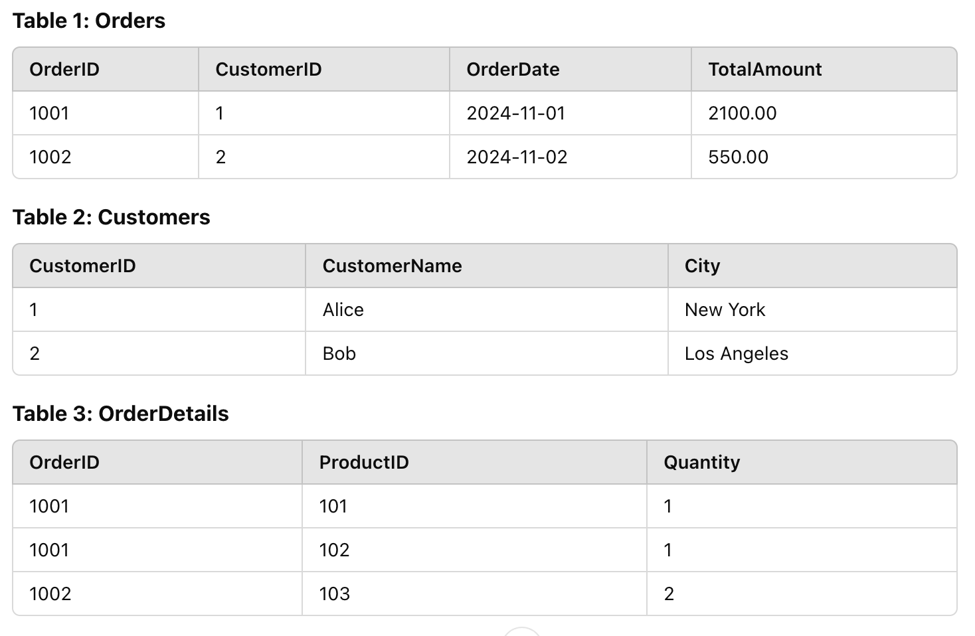
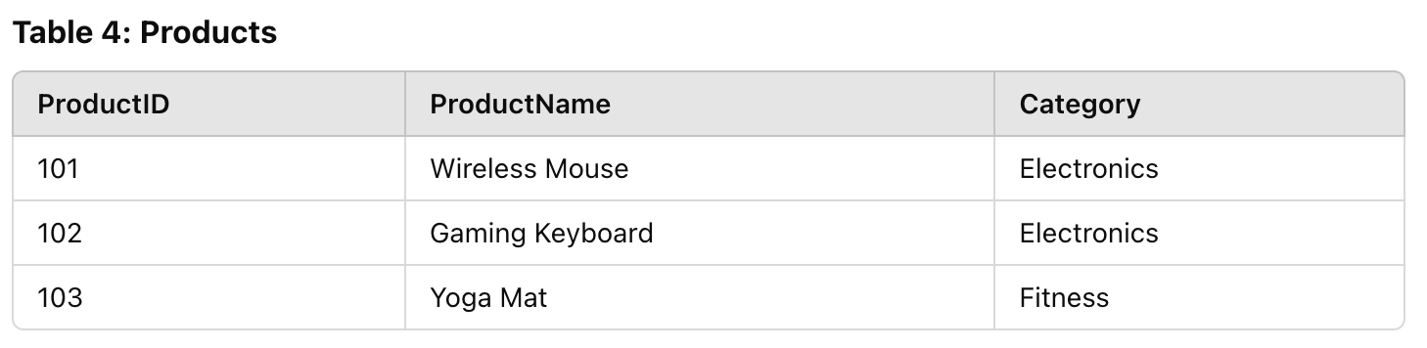
Denormalization

Slide 7
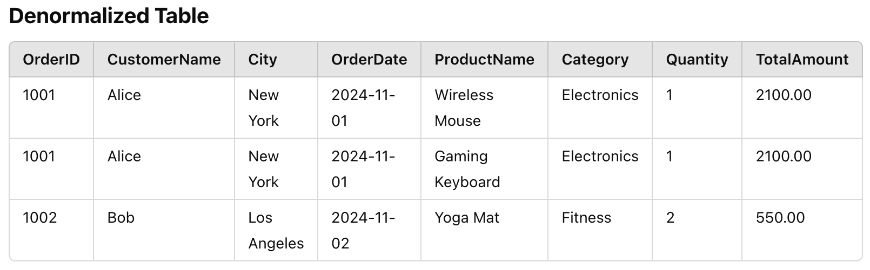
Denormalization

Slide 8
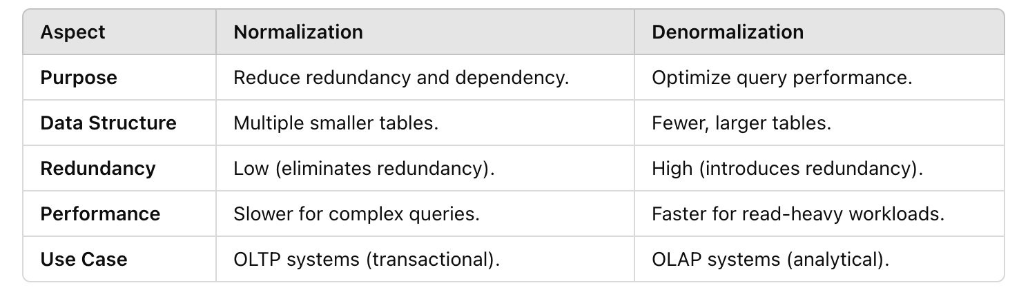
Normalization and Denormlization : Key differences

Slide 9
Benefits and Challenges of Normalization & Denormalization
Normalization:
Benefits:
Efficient use of storage.
Ensures consistency and eliminates anomalies.
Challenges:
Slower query performance due to joins.
Denormalization:
Benefits:
Improved query performance.
Simplified schema for reporting.
Challenges:
Increases storage requirements.
Risk of data anomalies due to redundancy.

Slide 10
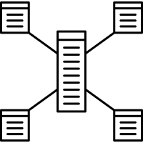
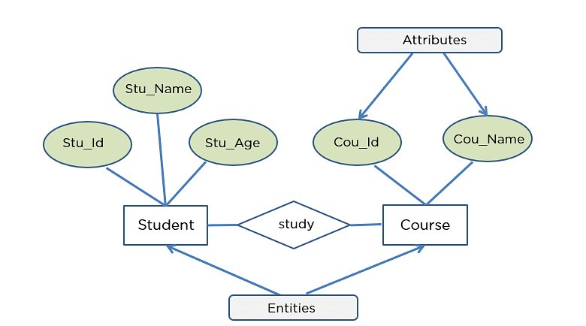
Dimensional Modeling vs. Entity-Relationship Modeling
Definition of Dimensional Modeling (DM):
Focused on analytical querying and reporting.
Optimized for high-performance data retrieval in Data Warehouses.
Star or Snowflake schemas with Fact and Dimension tables.
Definition of Entity-Relationship Modeling (ERM):
Focused on capturing detailed transactional data.
Used in operational databases.
Normalized schemas to avoid redundancy.

Slide 11
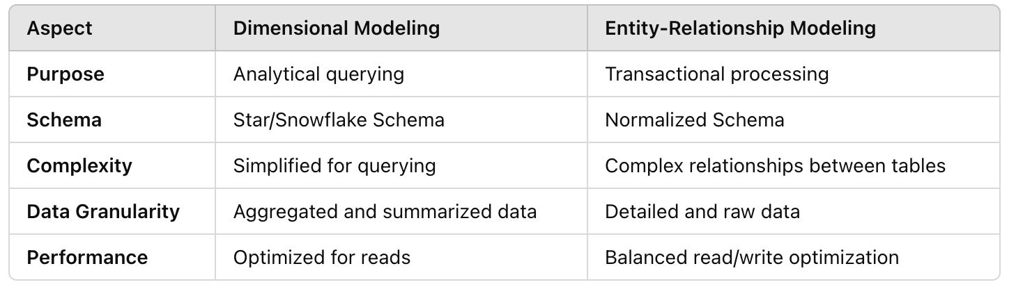
Dimensional Modeling vs. Entity-Relationship Modeling- Key Differences

Slide 12
DM vs. ERM : When to Use Each Approach?
Dimensional Modeling:
Business Intelligence and Data Warehousing.
Faster aggregation and reporting (e.g., sales analysis).
Entity-Relationship Modeling:
Operational databases for daily transactions.
Ideal for systems like banking, e-commerce, or CRM.

Slide 13
Introduction to Dimensional Modeling
Definition:
A design technique for data warehouses optimized for analytical queries.
Key Features:
Simple schema design for faster queries (Star/Snowflake).
Focuses on business processes.
Separation of Facts (measurable data) and Dimensions (descriptive attributes).

Slide 14
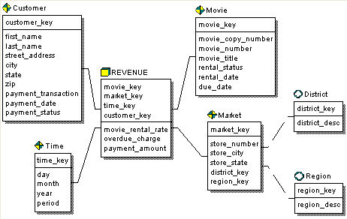
Example

Slide 15
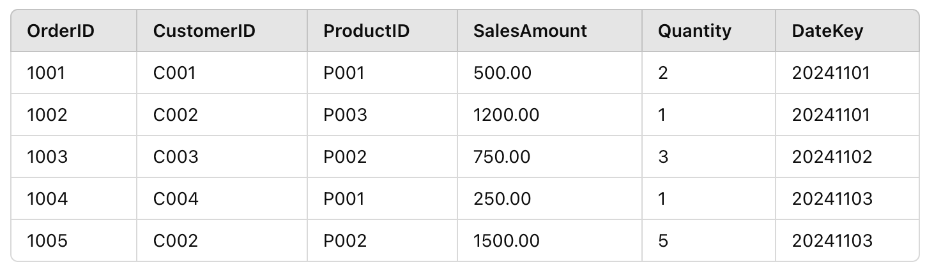
Dimensional Modeling: Fact Tables
Definition: Store measurable and quantitative data, typically numeric.
Types of Facts:
Additive: Can be summed across dimensions (e.g., Sales Amount).
Semi-additive: Can be summed partially (e.g., Account Balance).
Non-additive: Cannot be summed (e.g., Ratios).
Characteristics:
Contain foreign keys to Dimensions.
Large and constantly growing.

Slide 16
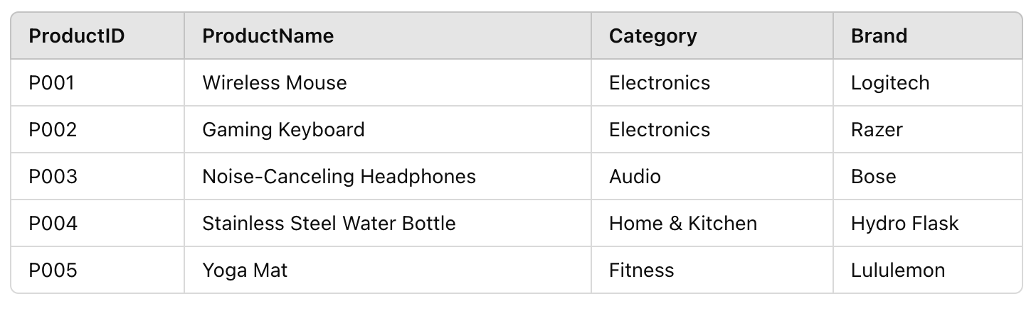
Dimensional Modeling: Dimension Tables
Definition: Contain descriptive, textual, or categorical data that adds context to facts.
Key Characteristics:
Typically smaller than Fact tables.
Include attributes for filtering and grouping (e.g., Region, Category, Time Period).
Examples of Dimensions:
Product Dimension: Product ID, Name, Category, Brand.
Time Dimension: Date, Month, Quarter, Year.
Customer Dimension: Customer ID, Name, Location, Segment.

Slide 17
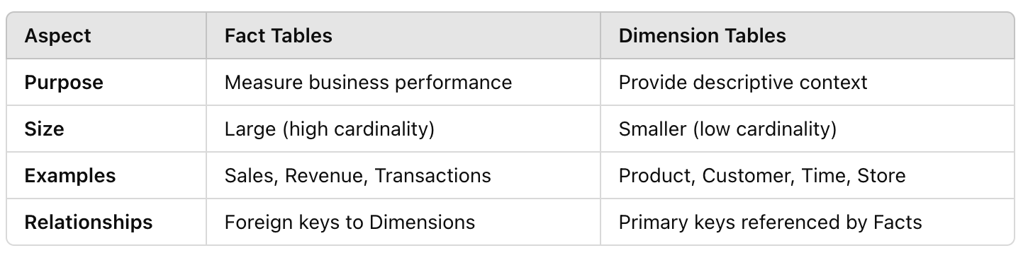
Dimensional Modeling: Fact Tables vs. Dimension Tables

Slide 18
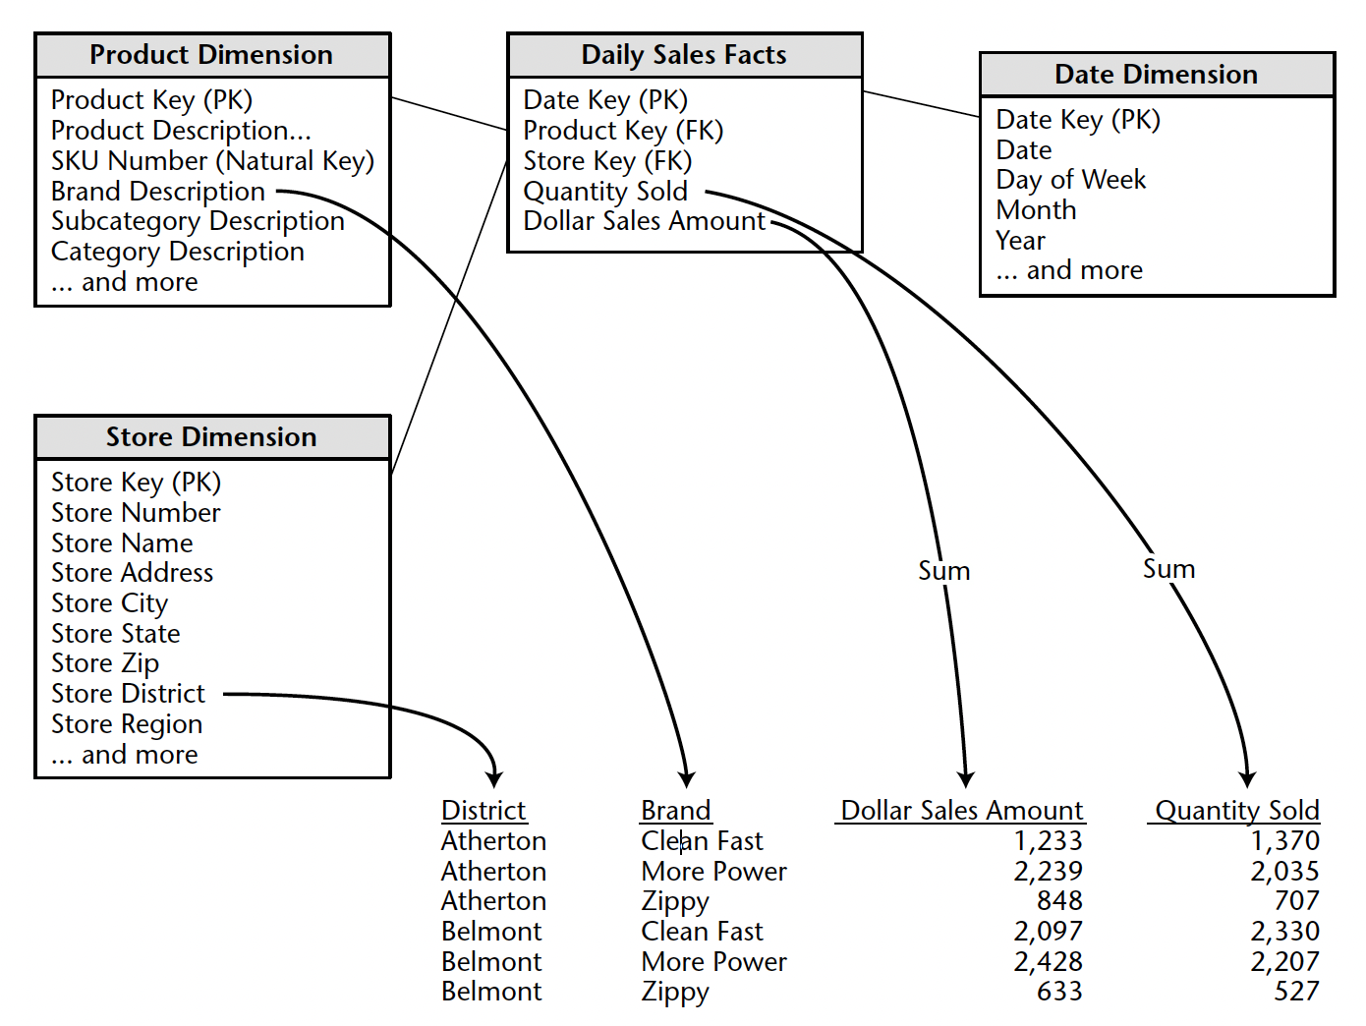
Data Model

Slide 19
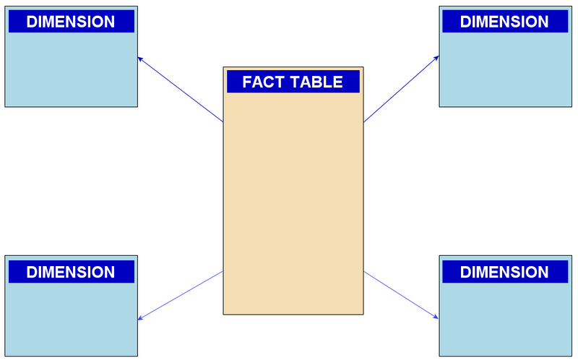
Star Schema
Definition:
A schema design where a central Fact Table is directly connected to multiple Dimension Tables.
Characteristics:
Simple and intuitive structure.
Faster query performance due to fewer joins.
Denormalized dimensions (redundant data for simplicity).
Use Case:
Ideal for reporting and analytical workloads with straightforward relationships.

Slide 20
Snowflake Schema
Definition:
A schema design where Dimension Tables are further normalized into multiple related tables.
Characteristics:
More complex structure compared to Star Schema.
Requires more joins, leading to slower query performance.
Reduces data redundancy by normalizing dimensions.
Use Case:
Suitable for scenarios where storage optimization is crucial.

Slide 21
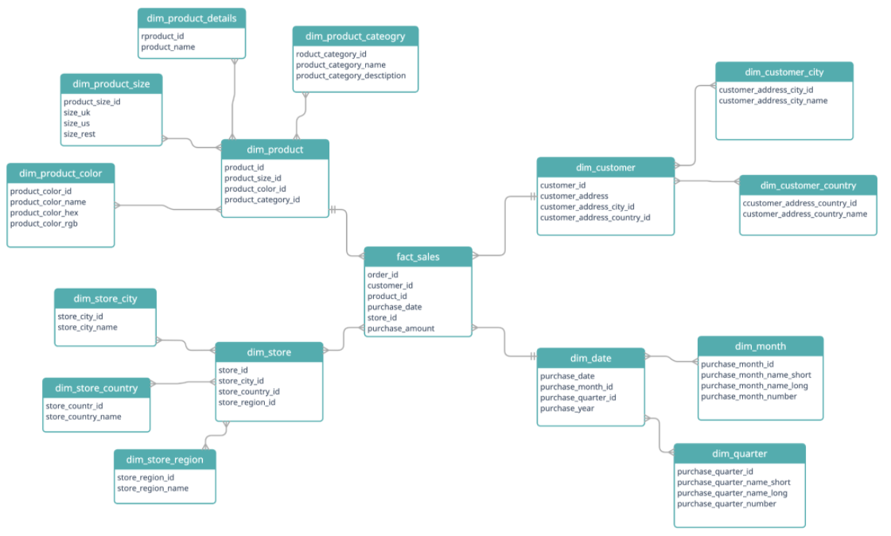

Slide 22
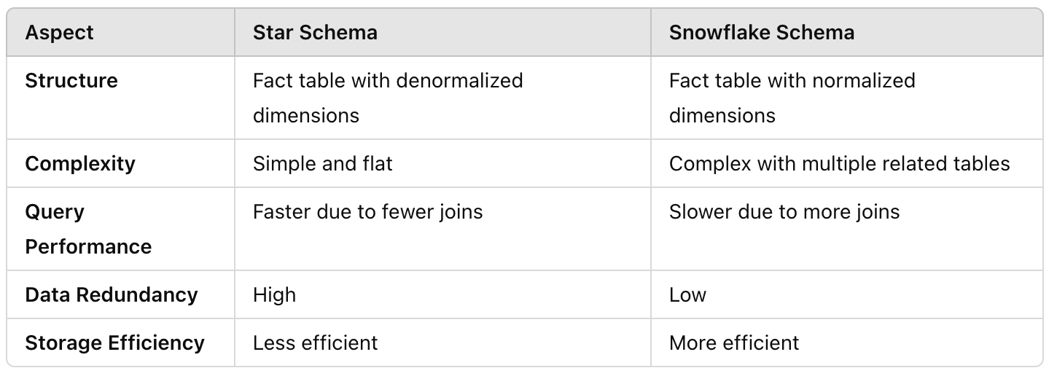
Comparing Star and Snowflake Schemas

Slide 23
Slowly Changing Dimensions (SCD)
Definition:
Slowly Changing Dimensions (SCD) handle changes in dimension data over time while preserving historical accuracy.
Why SCD is Important:
Dimensions often evolve (e.g., a customer changes their address or a product gets rebranded).
Ensures accurate reporting and trend analysis.
Key Challenge:
Balancing historical integrity with current data relevance.

Slide 24
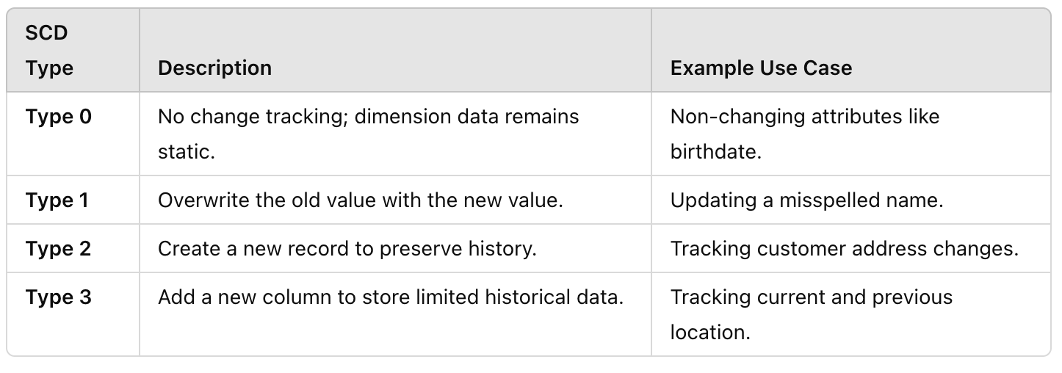
Slowly Changing Dimensions (SCD) Techniques

Slide 25
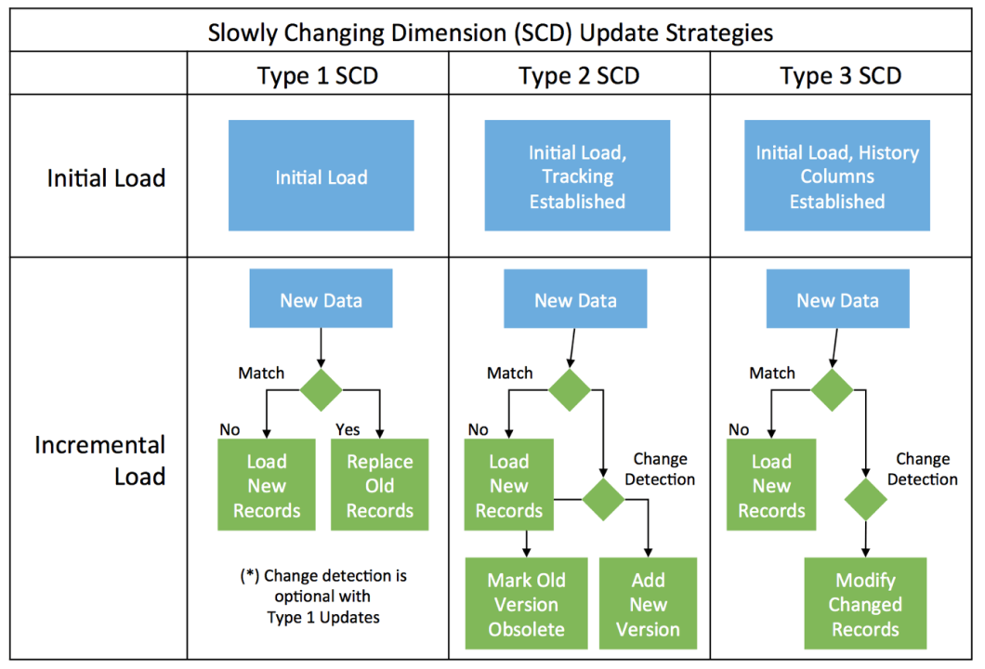

Slide 26

End of the Lecture # 2
Qustions ?? (5mins)
Open disscuation .. (3mins)

